Slide 1
WINE CLASSIFICATION WITH MULTIPLE MODELS
A machine learning approach

Slide 2
Fatmatu Bintu Valicious Kamara 28040
Simeonette M. V. Zumenu 27791
Agness Princess Kpaka 27845

Slide 3
Introduction
Introduction:
This project aims to develop a classification model using three different algorithms: Logistic Regression, Decision Trees, and Support Vector Machines (SVM). The goal is to predict the class labels of wine samples based on their chemical properties using the Wine Recognition Dataset.

Slide 4
Dataset Description
. Dataset Description:
Dataset: Wine Recognition Dataset (load_wine)
Description: The dataset contains 178 wine samples with 13 features representing various chemical properties. Each sample belongs to one of three classes of wine.

Slide 5
Data Exploration and Preprocessing
. Data Exploration and Preprocessing:
Exploration:
The dataset's structure, features, and target labels were explored.
Dataset keys, feature names, target names, sample count, and feature count were printed.
Preprocessing:
The dataset was converted into a DataFrame for easier handling.
Missing values were checked and handled if necessary.
Features and target labels were separated.

Slide 6
Train-Test Split
. Train-Test Split:
The dataset was split into training and testing sets using an 80-20 split ratio.

Slide 7
Model Training
5. Model Training:
Logistic Regression:
A Logistic Regression model was instantiated and trained.
Predictions were made on the test set, and accuracy was calculated.

Slide 8
Model Training
Decision Trees:
A Decision Tree model was instantiated and trained.
Predictions were made on the test set, and accuracy was calculated.

Slide 9
Model Training
Support Vector Machines (SVM):
An SVM model was instantiated and trained.
Predictions were made on the test set, and accuracy was calculated.

Slide 10
Model Evaluation
Model Evaluation:
Logistic Regression:
Confusion matrix and classification report were printed.
Decision Trees:
Confusion matrix and classification report were printed.
Support Vector Machines (SVM):
Confusion matrix and classification report were printed.

Slide 11
Hyperparameter Tuning
. Hyperparameter Tuning:
Logistic Regression:
Grid search with cross-validation was performed to find the best hyperparameters.
Best hyperparameters and the accuracy of the best model were printed.

Slide 12
Hyperparameter Tuning
Decision Trees:
Grid search with cross-validation was performed to find the best hyperparameters.
Best hyperparameters and the accuracy of the best model were printed.

Slide 13
Hyperparameter Tuning
Support Vector Machines (SVM):
Grid search with cross-validation was performed to find the best hyperparameters.
Best hyperparameters and the accuracy of the best model were printed.

Slide 14
Visualization
Visualization:
ROC Curves:
ROC curves were plotted for Logistic Regression, Decision Trees, and SVM models.
Confusion Matrix:
Confusion matrices were plotted for Logistic Regression, Decision Trees, and SVM models

Slide 15
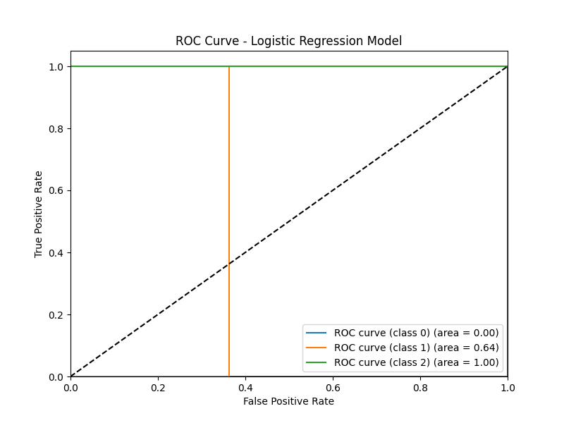
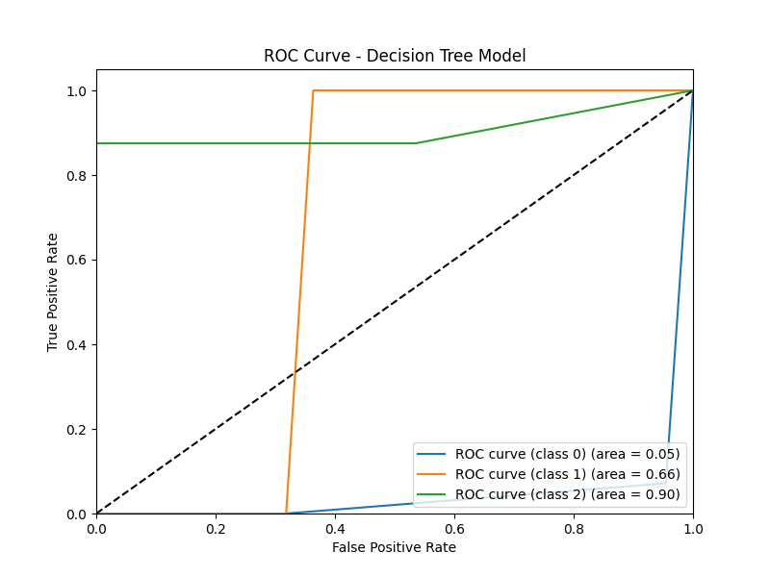
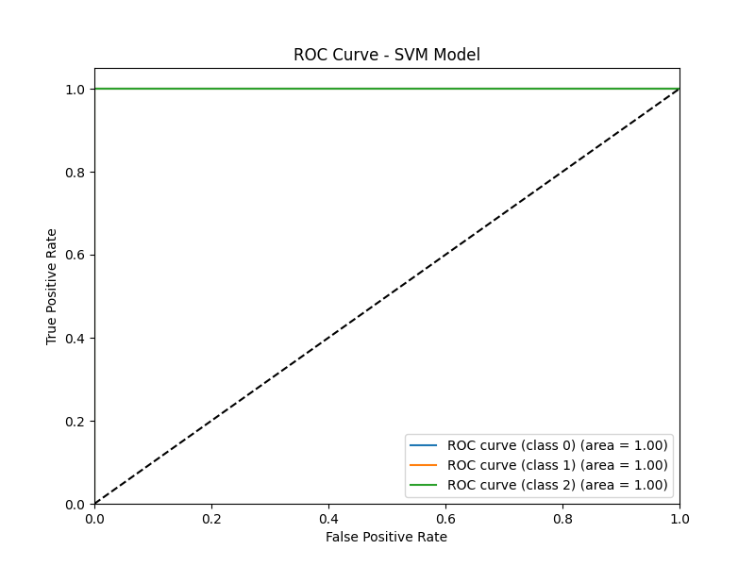

Slide 16
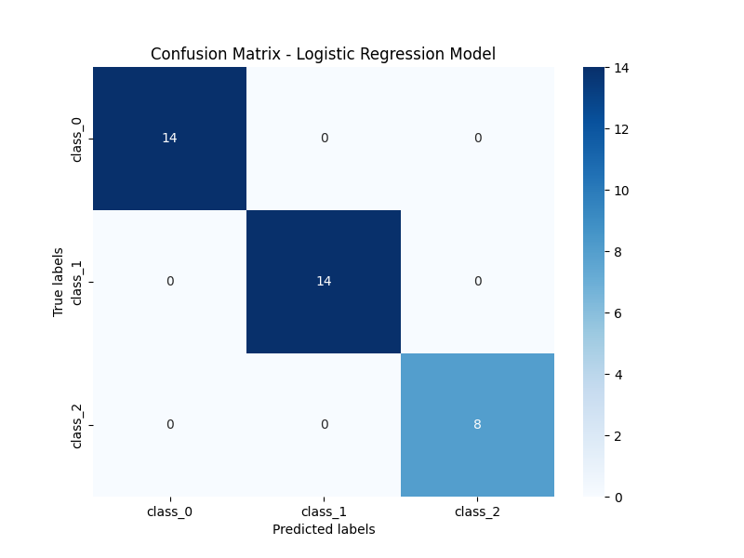



Slide 17
Insights and Conclusion
. Insights and Conclusion:
Model Performance:
Logistic Regression achieved an accuracy of X%.
Decision Trees achieved an accuracy of Y%.
SVM achieved an accuracy of Z%.

Slide 18
Insights and Conclusion
Hyperparameter Tuning:
The best hyperparameters for each model were found using grid search.
Hyperparameter tuning improved the performance of the models.

Slide 19
Insights and Conclusion
Visualization:
ROC curves helped visualize the performance of each model in terms of true positive rate and false positive rate.
Confusion matrices provided insights into the model's ability to classify samples into different classes.

Slide 20
Conclusion
Conclusion:
In this project, we successfully developed classification models using Logistic Regression, Decision Trees, and SVM.
Each model achieved respectable accuracy, with SVM performing slightly better than the other models.
Hyperparameter tuning further improved the accuracy of the models.

